Slide 1

Library Management
By:
Aishwarya Ramaiah Kumar
Kartavi Manishkumar Shah
Rishabh Singh

Slide 2
Problem Statement:
Bookstore will not keep track of its books, customer and employees.
There must be times when books are in demand and store would not stock.
Accounting would be very difficult.

Slide 3
Solution:
This project aims at computerizing the process of Library.
This project will help to create the Library to know information of the books, customers and employee.
Authors, customers and publisher information will also be available for detailed description.

Slide 4
Project Benefit:
Library management system will facilitate the process of entering book records and obtaining information on the books available , book transaction and book holders.
Customer can check how many or which books are available in the library.
Bookstore can stock the books when stocks are low.

Slide 5
Entities:
01
02
03
Employee
Bookstore
Customer
04
05
06
Books
Publisher
Author
Notes:
Note: you can add between 3 and 6 sections, the structure can vary. The numbers have to be kept

Slide 6
Query
CREATE DATABASE Library_Management

Slide 7
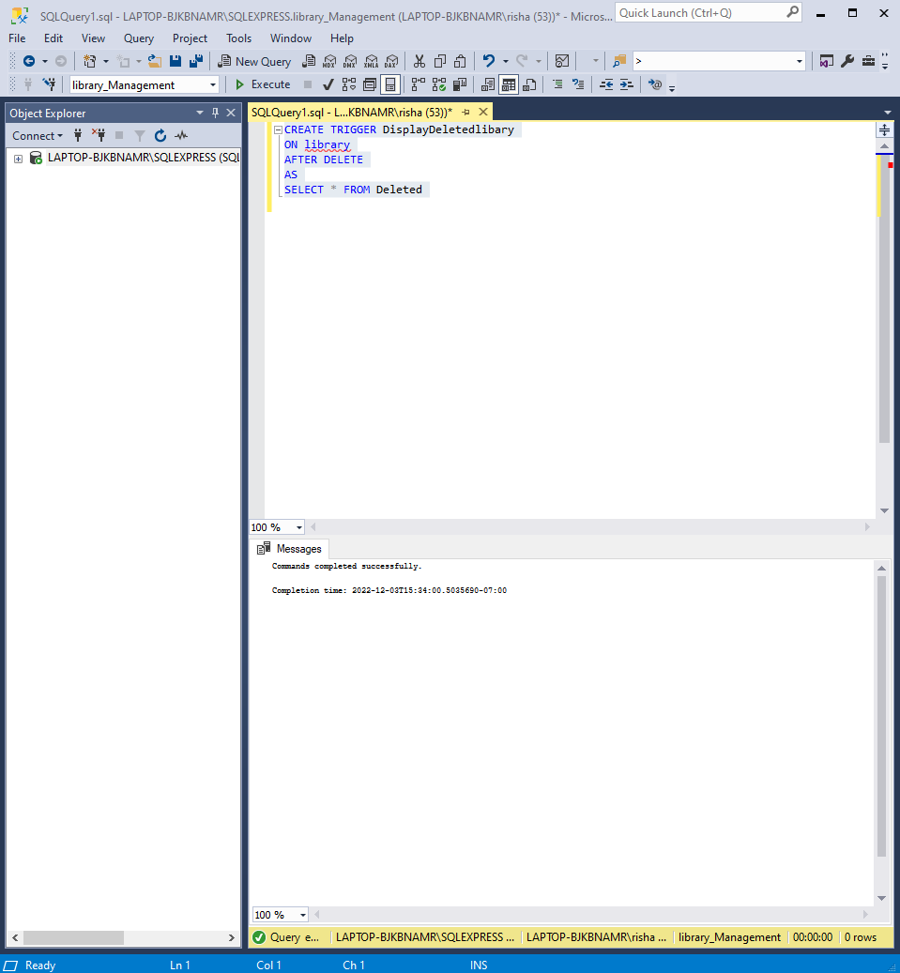

Slide 8
Query
Insert into Author (authorName)
values ('J.K Rowling'),
('R.S Aggarwal'),
('H.C Verma'),
('William Shakespeare'),
('Dan Brown');

Slide 9
Query
SELECT * FROM library
WHERE address=`Tempe`

Slide 10
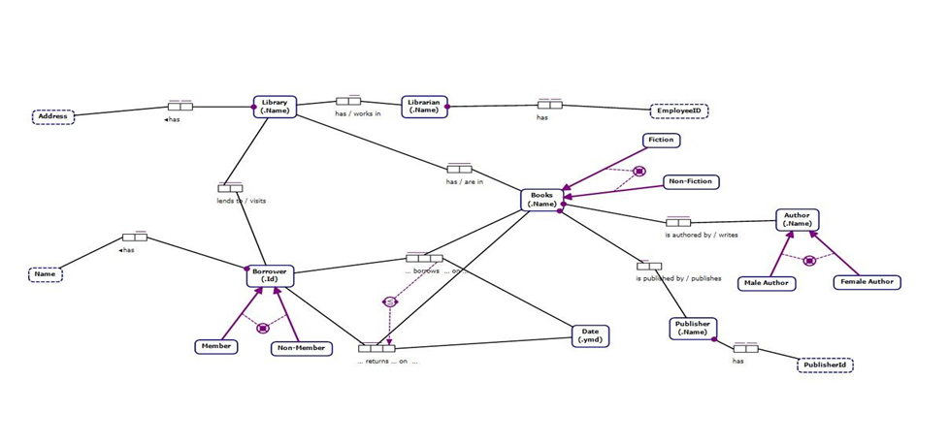
ORM Diagram

Slide 11
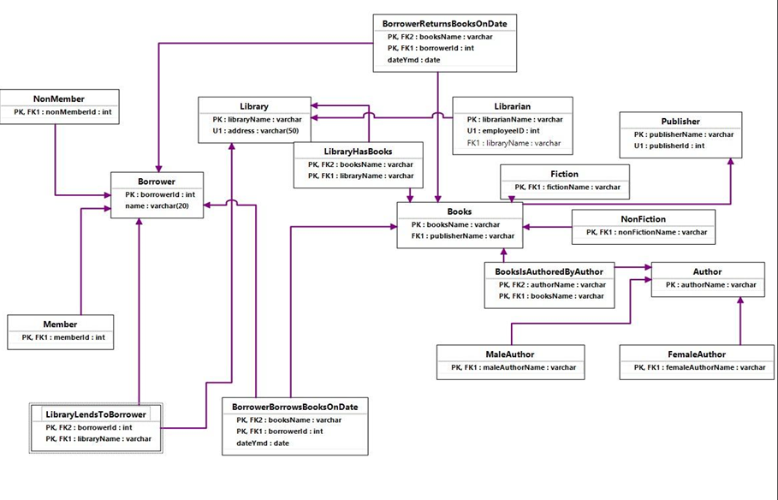
THE RELATIONAL SCHEMA

Slide 12
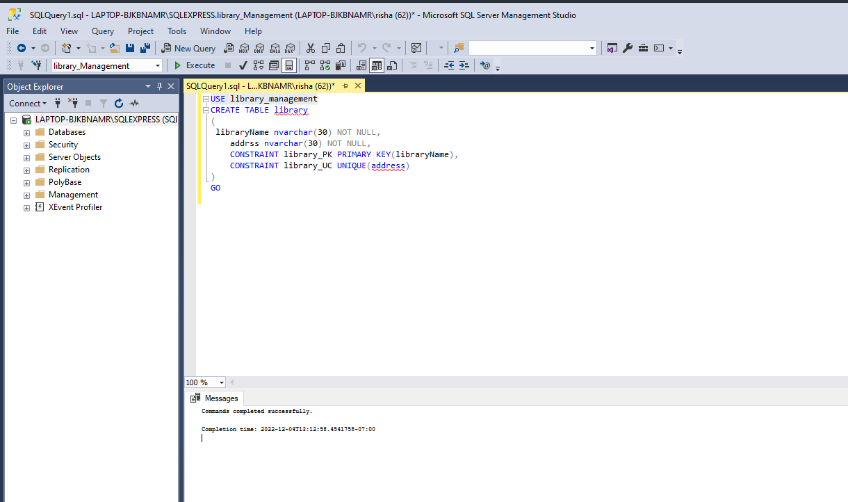
CREATING TABLES

Slide 13
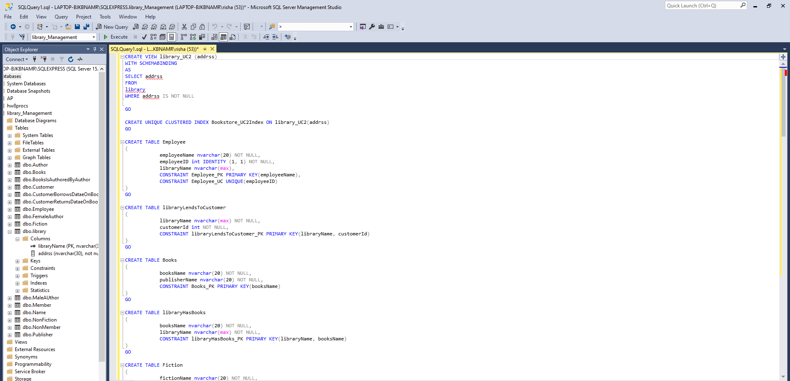

Slide 14
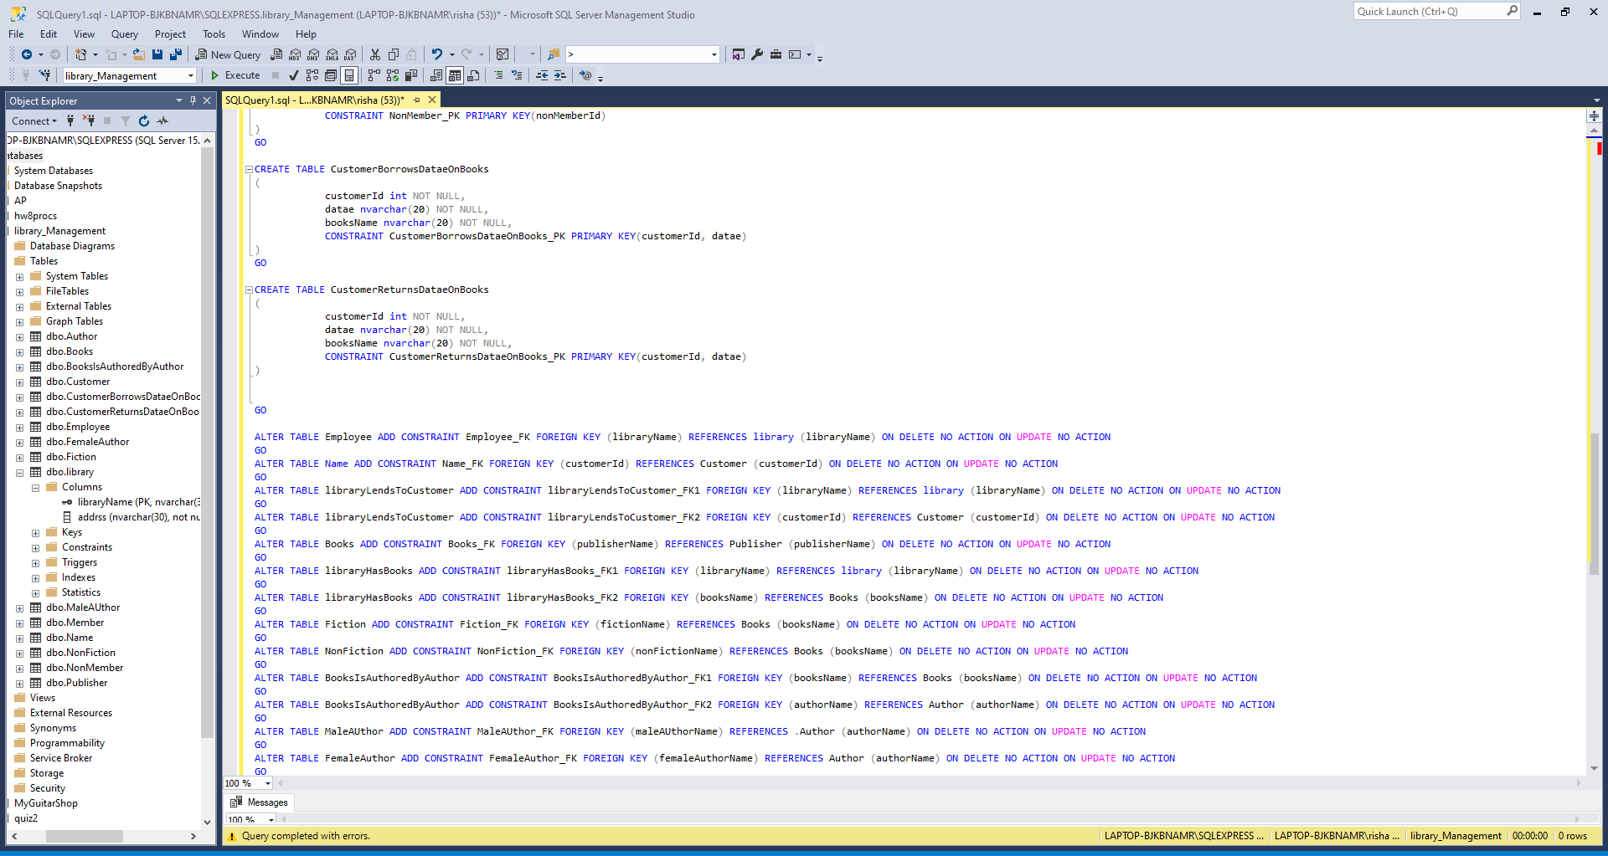
FOREIGN KEY CONSTRAINTS

Slide 15
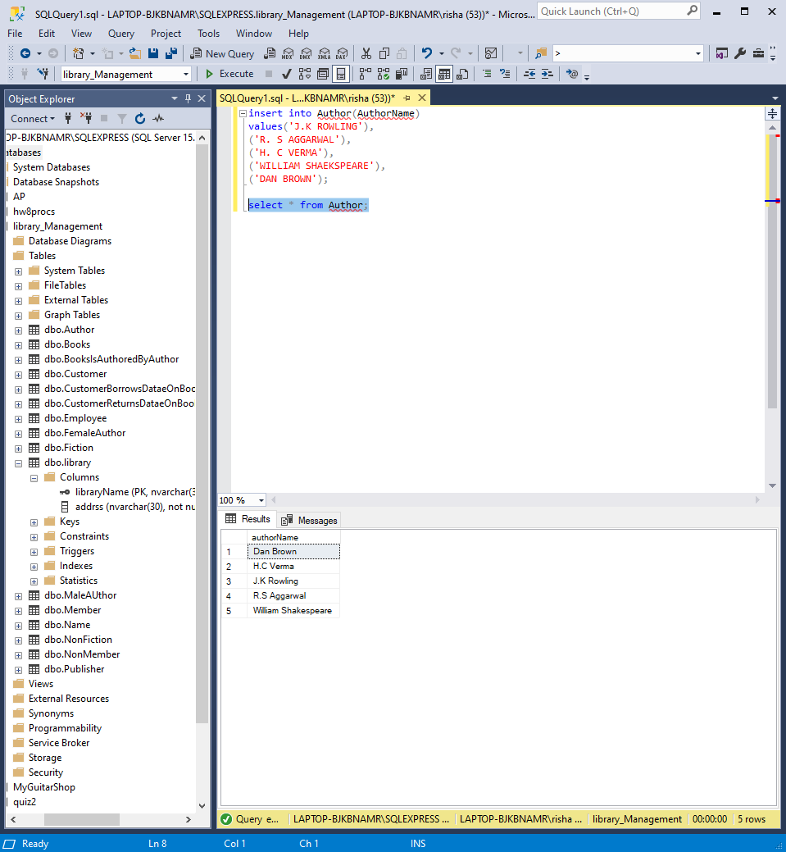
ADDING DATA TO TABLES

Slide 16
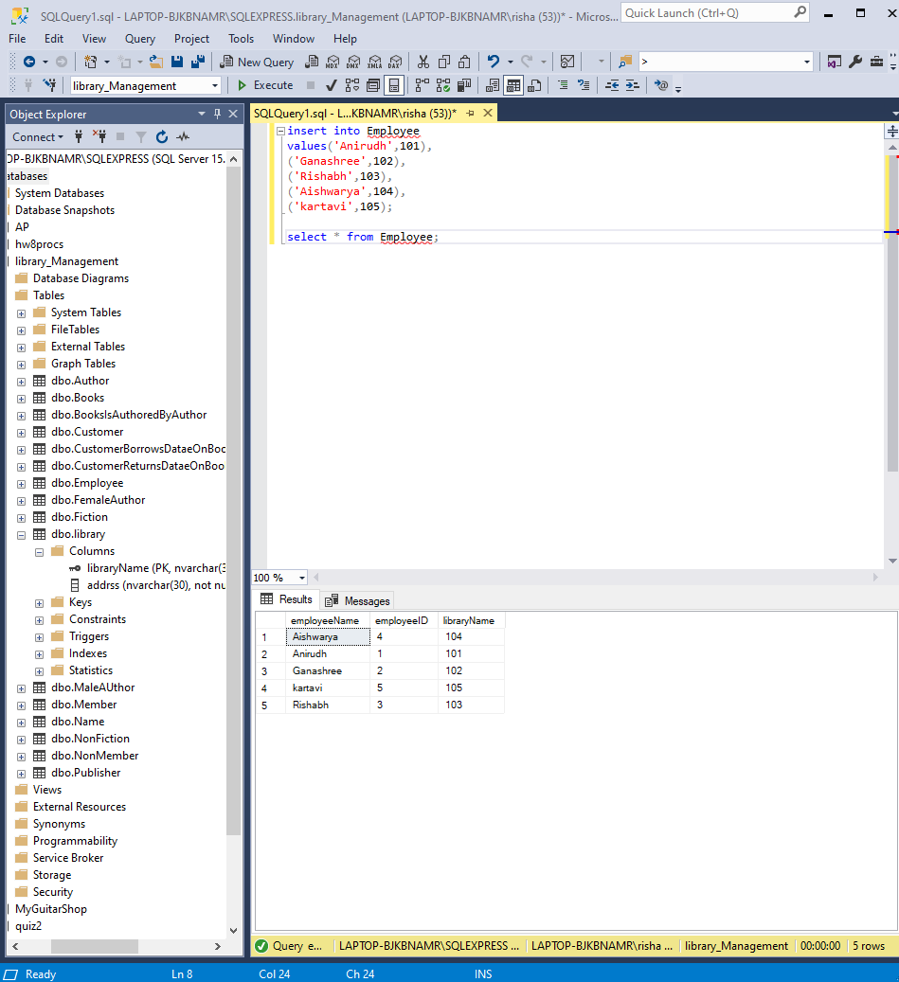

Slide 17
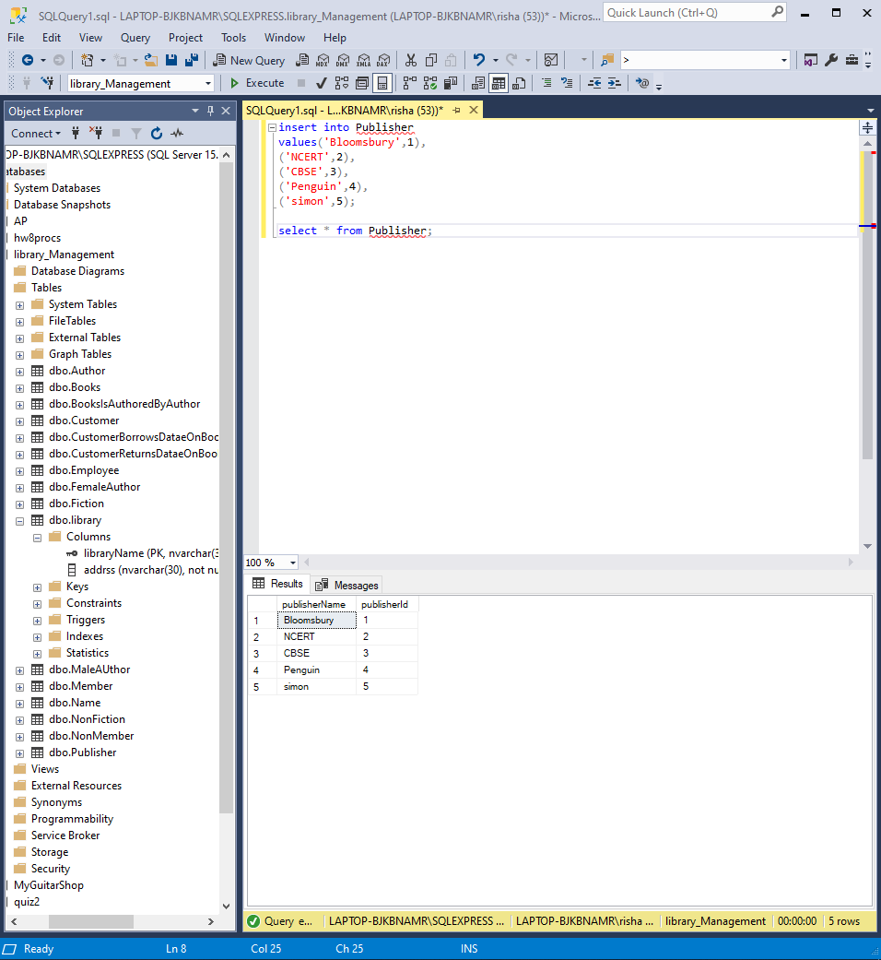

Slide 18
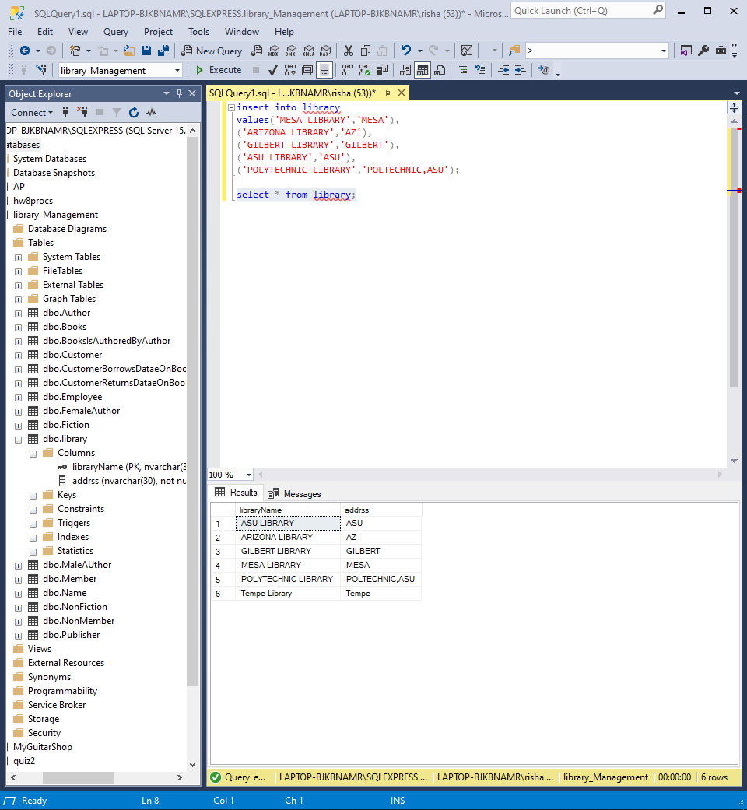

Slide 19
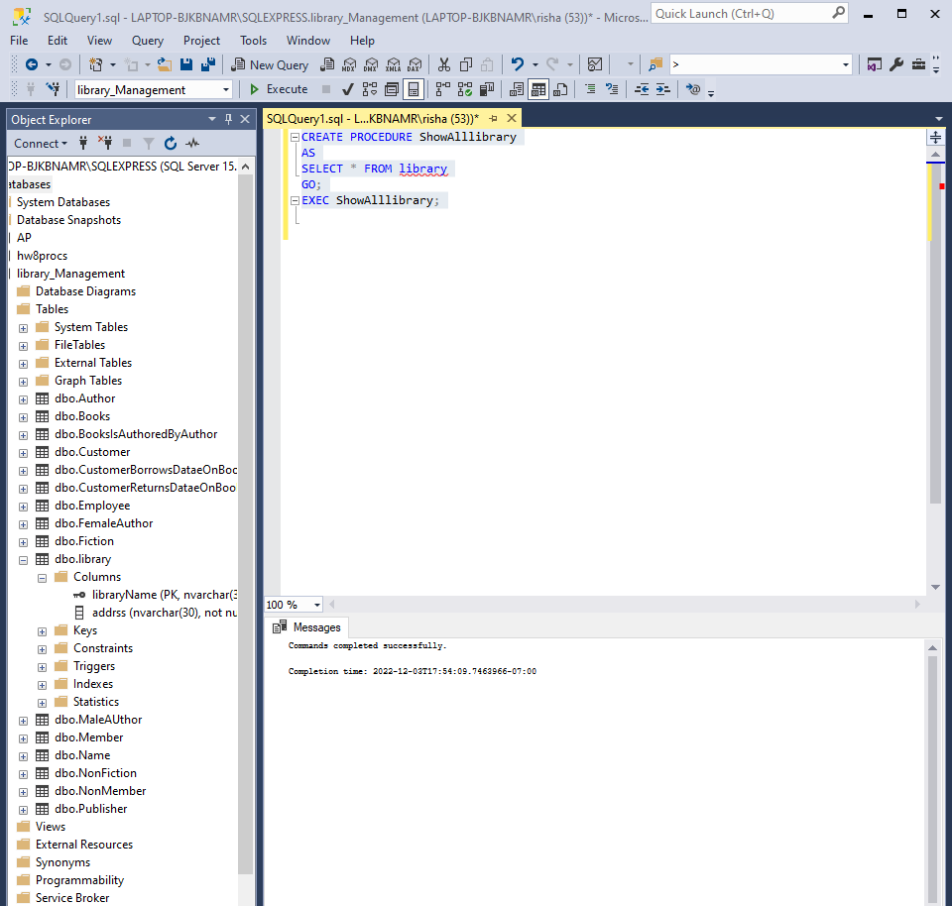
STORED PROCEDURES

Slide 20
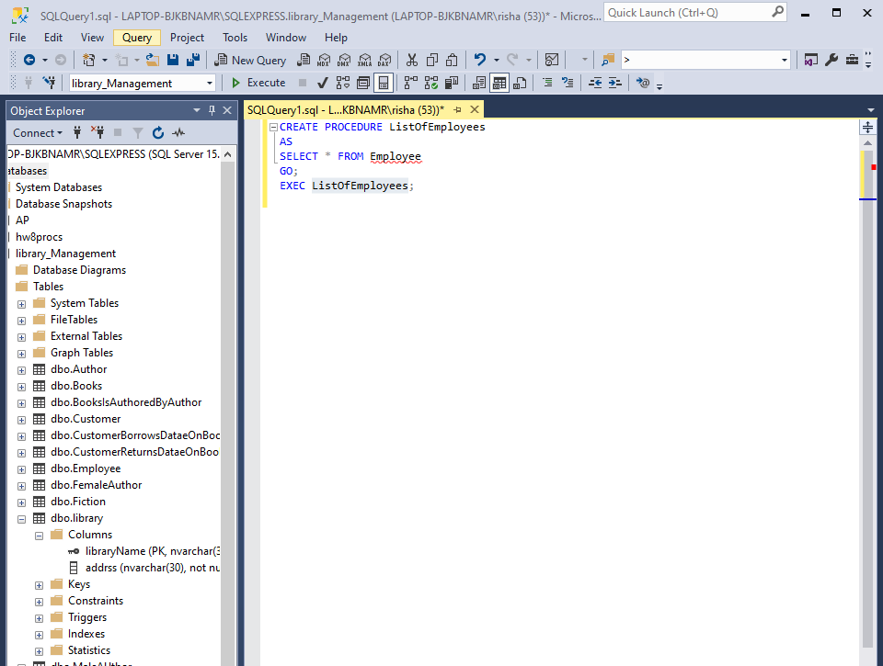

Slide 21
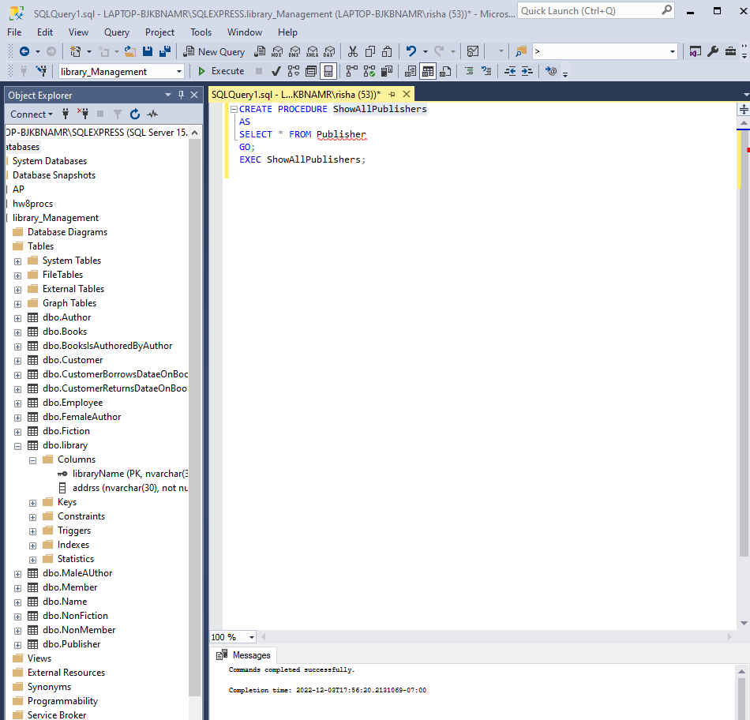

Slide 22
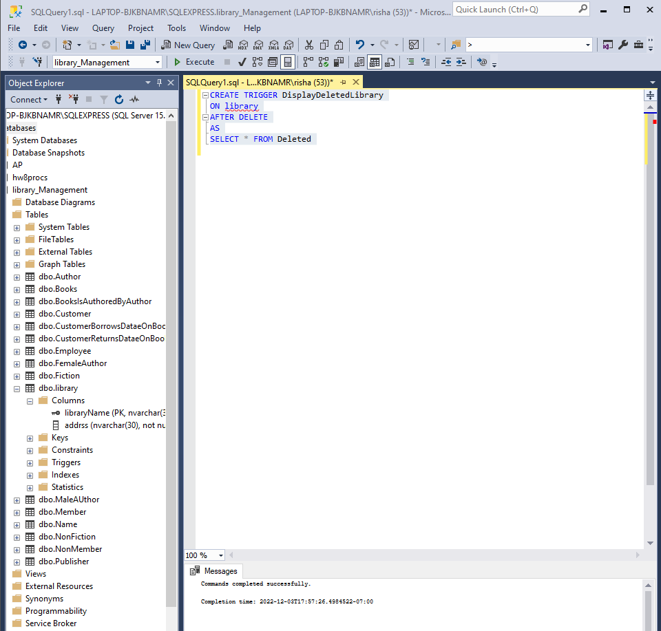
TRIGGERS

Slide 23
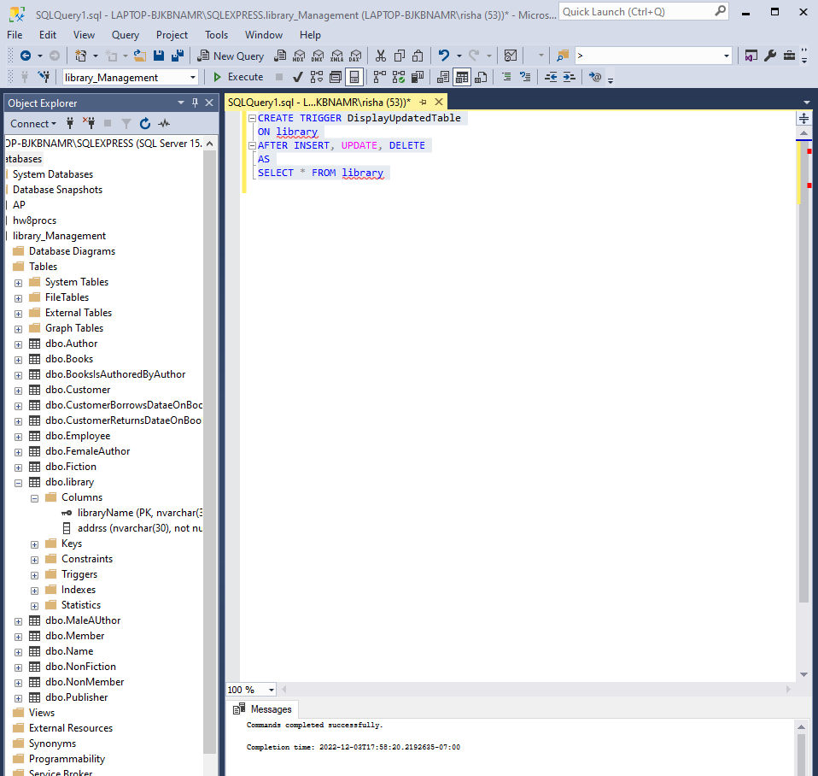

Slide 24
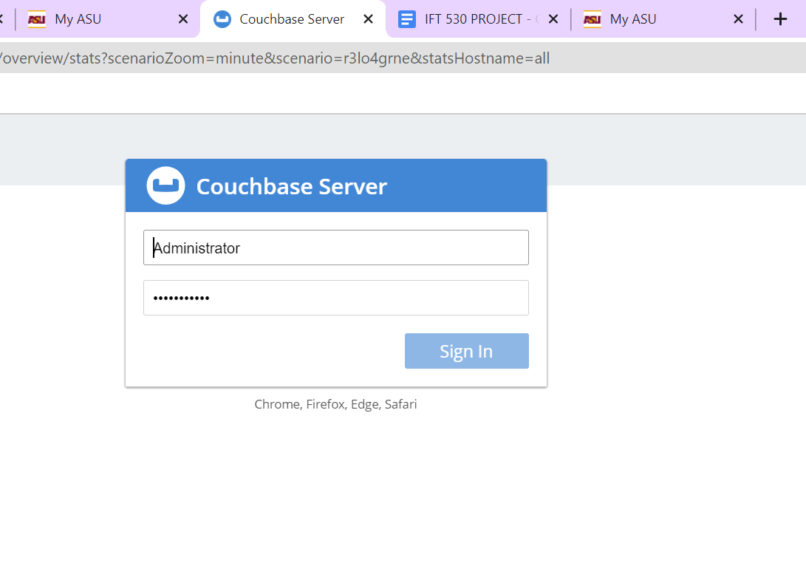
COUCHBASE(NOSQL) Configuration

Slide 25
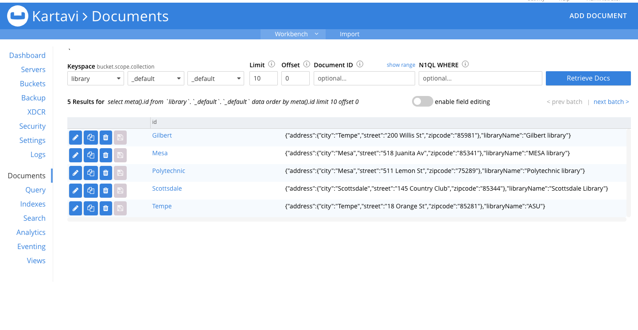
Documents of libraries

Slide 26

Document of Employees

Slide 27
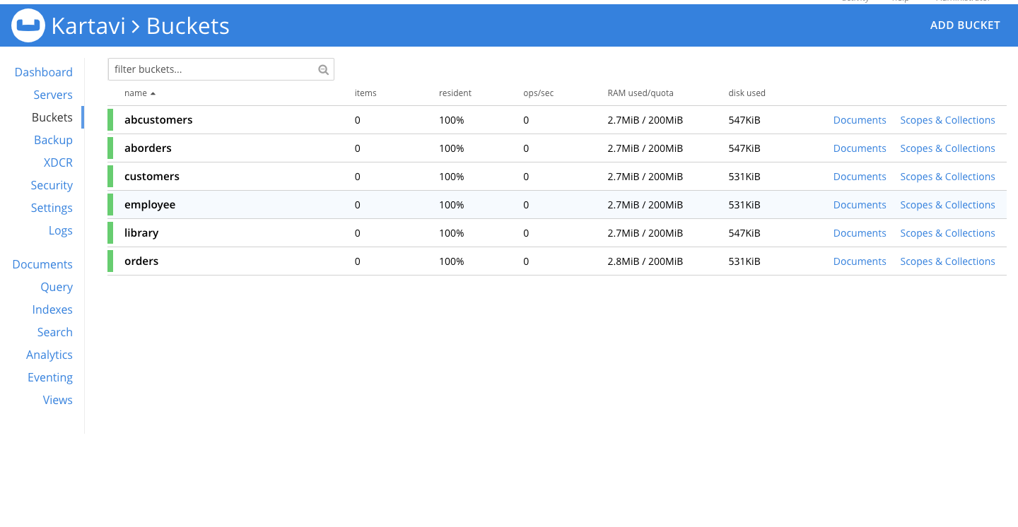
Created Buckets

Slide 28
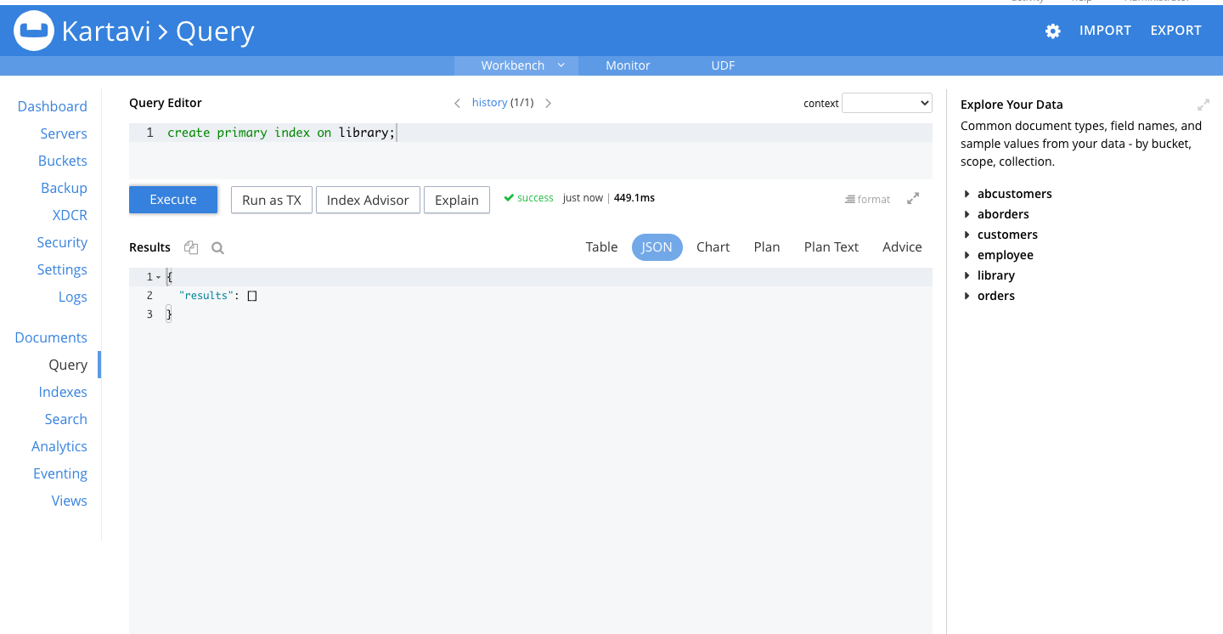
Created Primary Index on library

Slide 29

Created Primary Index on Employee

Slide 30
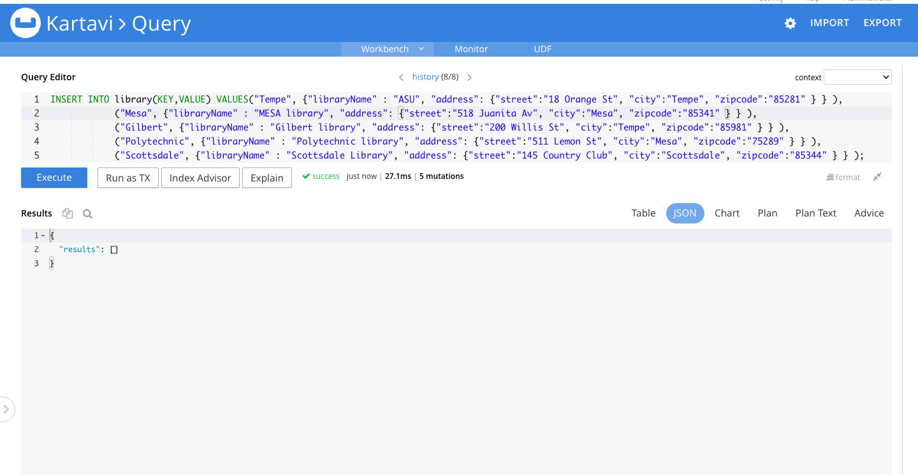
Inserting values into library Table

Slide 31
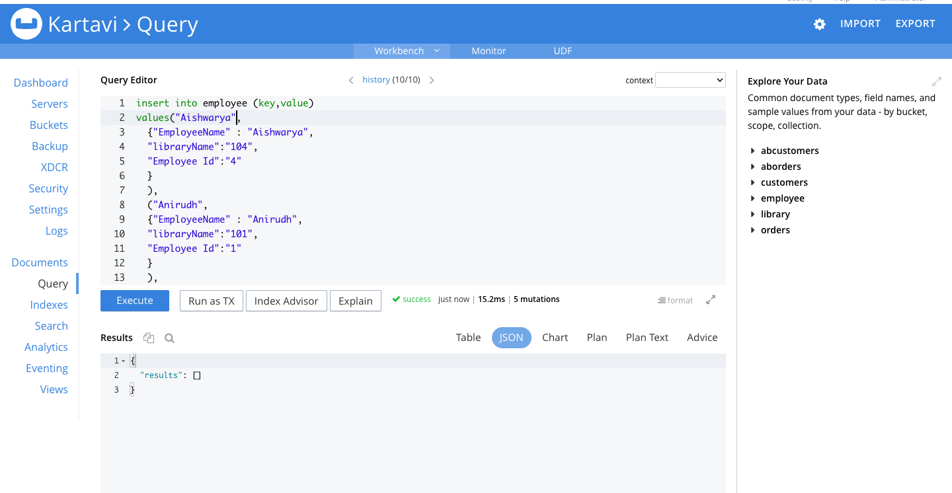
Inserting Values in Employee table

Slide 32
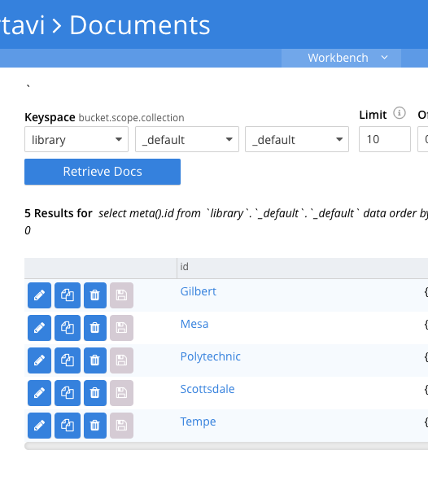

Json to Represent Data

Slide 33
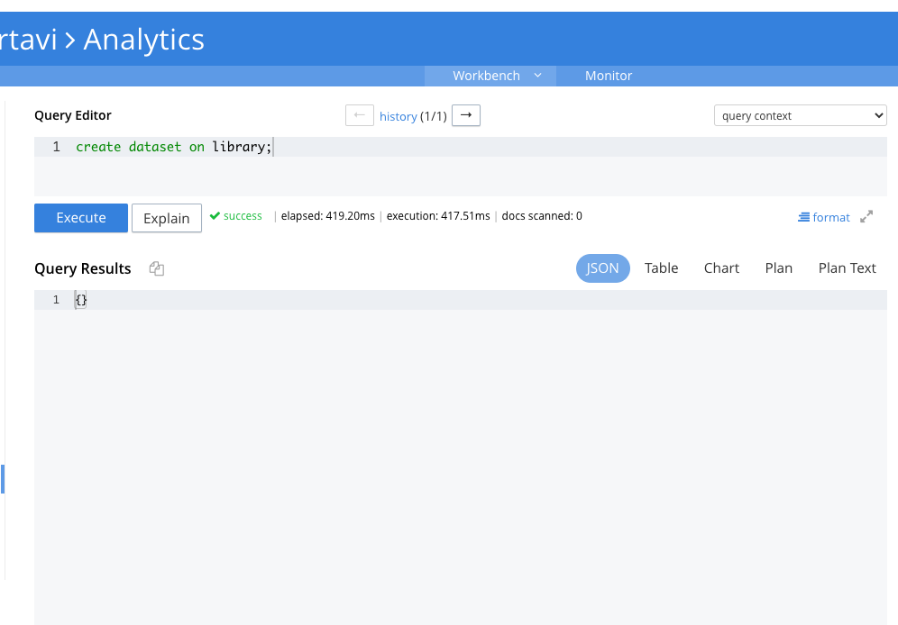
Creating dataset on library

Slide 34

Create dataset on employee

Slide 35
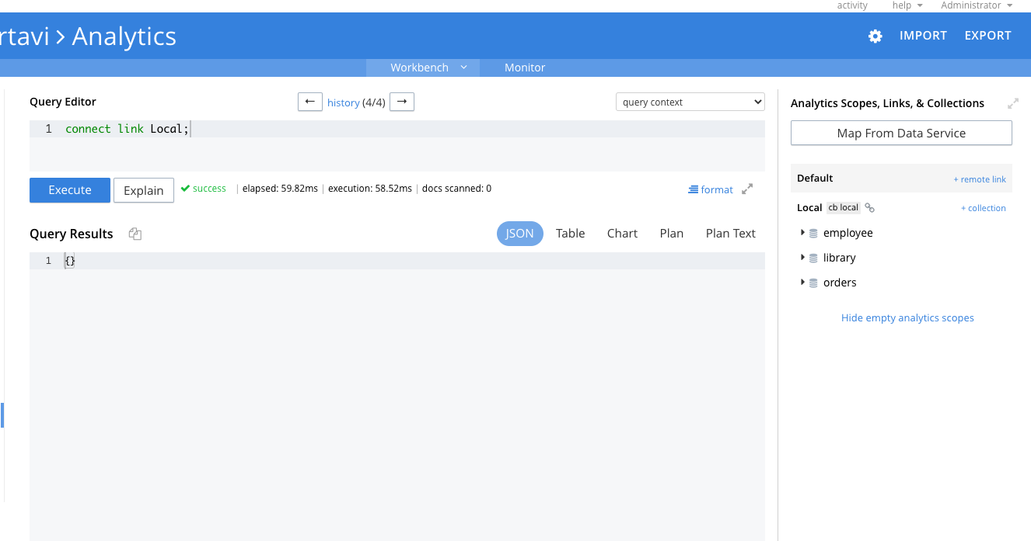
Connected the local link

Slide 36
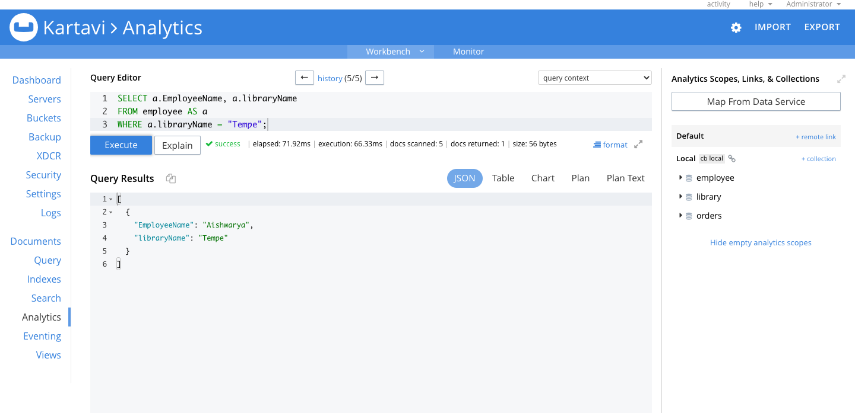
Running queries using analytics service

Slide 37
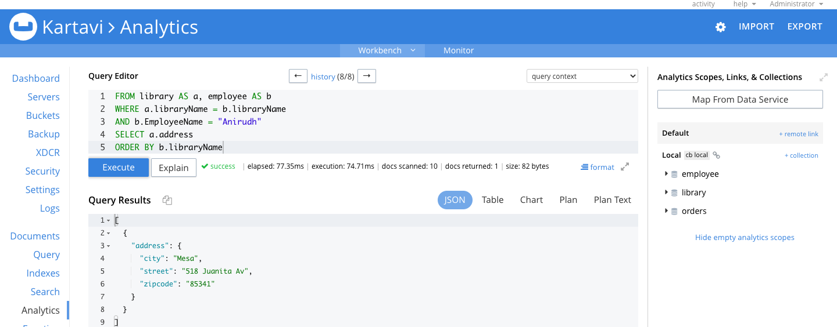

Slide 38
Conclusion

